Slide 1




AI based position estimation
based on radio frequency
Avichay Ashur
Itay Geva
046211 – Deep Learning
https://github.com/avichayyy/-AI-based-position-estimation

Slide 2

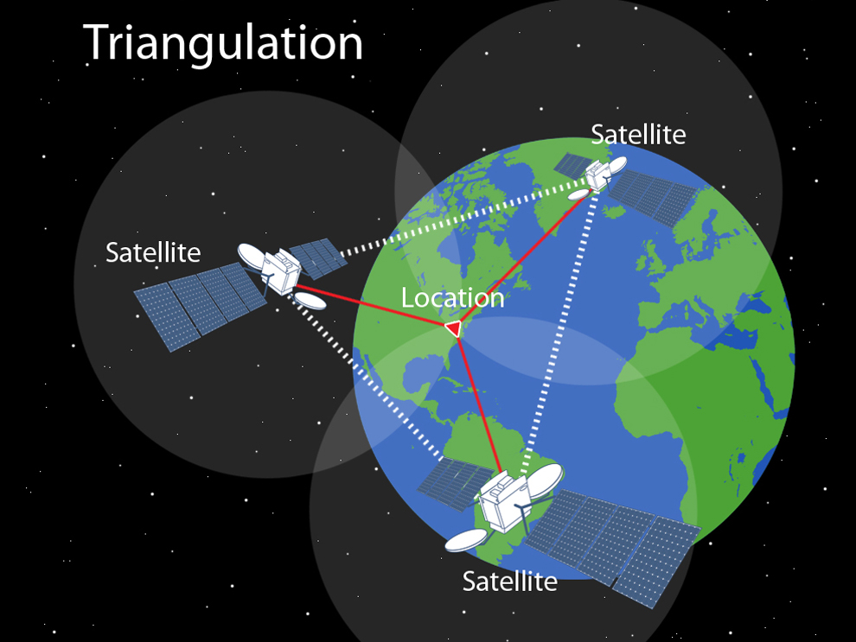
Introduction
Traditional approach for position estimation is GPS based – triangulation.
Triangulation suffers from:
1) power measurements are inconsistent:
Multi-Path / fading channels.
2) Lack of data:
low probability to detect more than one cell.
Thus, localization is reduced to strongest cell
→ errors of 100’s meters
AI has high potential to fit chip
measurements to reliable position.

Slide 3

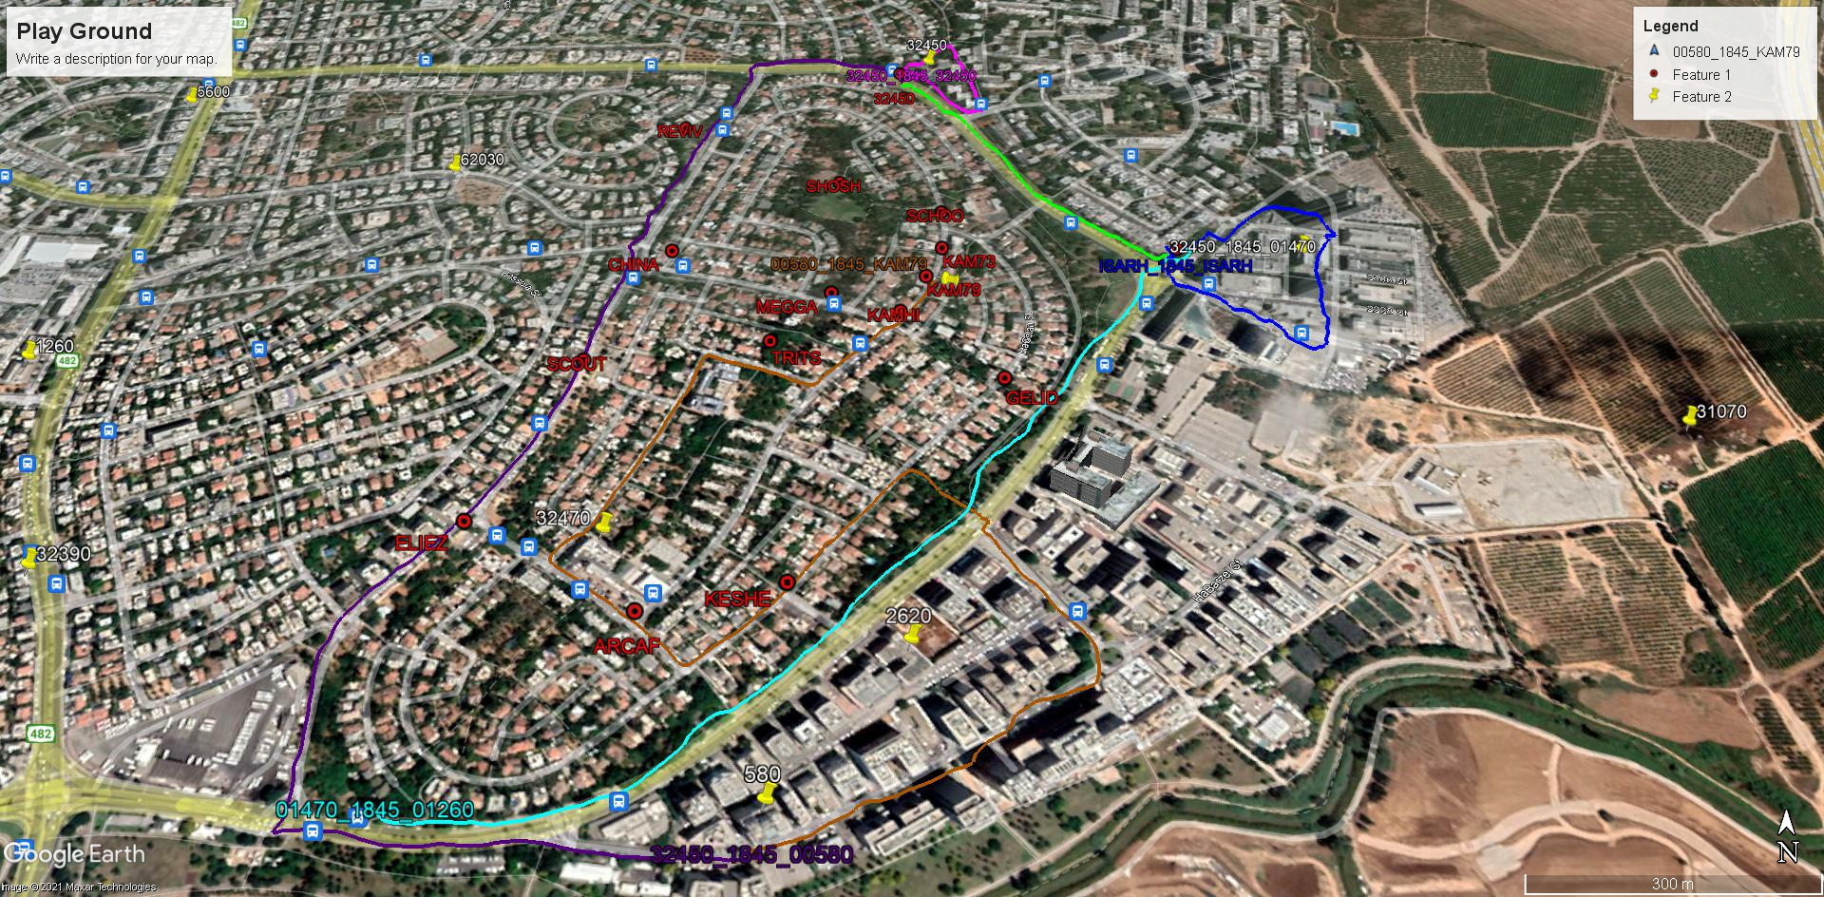

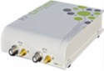
Data Collection
שכונת דבורה הנביאה בתל אביב

Slide 4
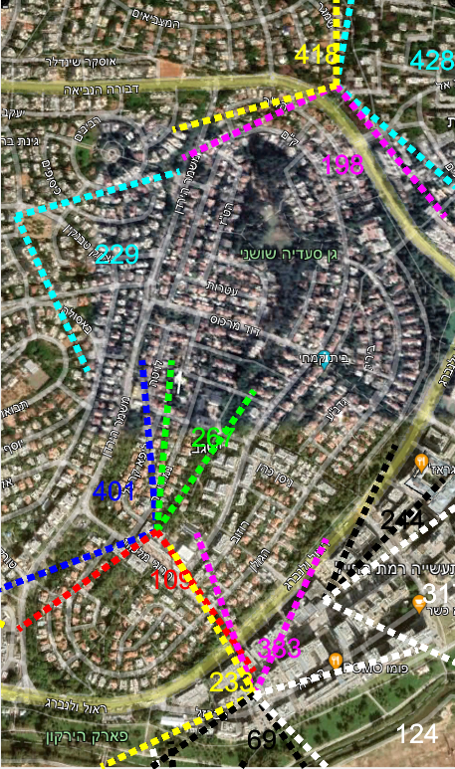
Feature extraction
For each frame, for every detected sector, the following data collected:
Wide band SNR per Tx
Narrow band SNR per Tx
Channel profile
MIB pass/fail
Features are concatenation of different measurement combinations
for 24 potential PCIs -> very sparse data.

Slide 5
Project Goal
Original Project was done using FC-NN & Decision Trees Model
MCT – Model Compression Toolkit is an open source project for neural network model optimization under efficient, constrained hardware. Only works for neural network
https://github.com/sony/model_optimization
Our Goal:
Achieve better results using CNN Architecture

Slide 6

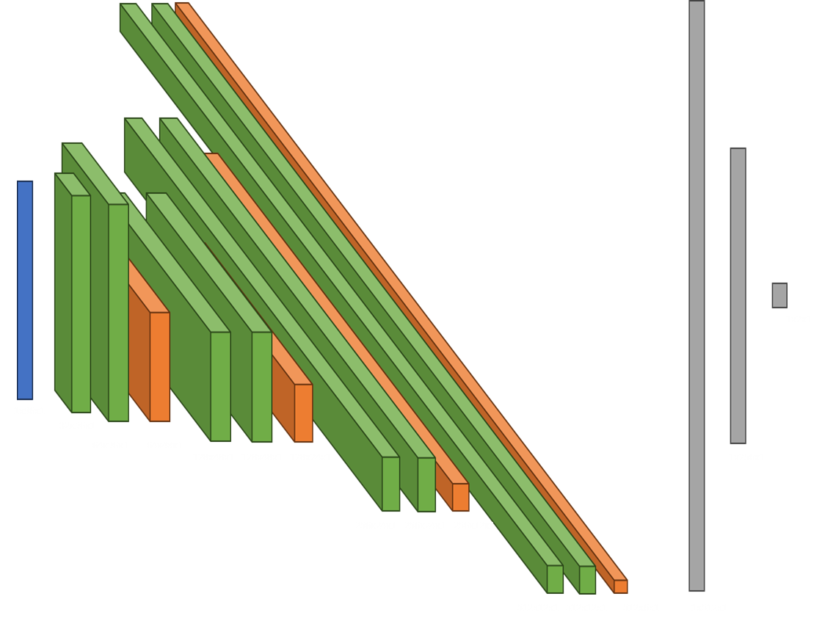

Model architecture
input
Conv, B.N, Relu
Conv, Relu
Max-Pool
Conv, Relu
Conv, Relu
Max-Pool
Conv, Relu
Conv, Relu
Max-Pool
Conv, Relu
Conv, Relu
Max-Pool
FC, Dropout, Relu
FC, Relu
FC - Output

Slide 7
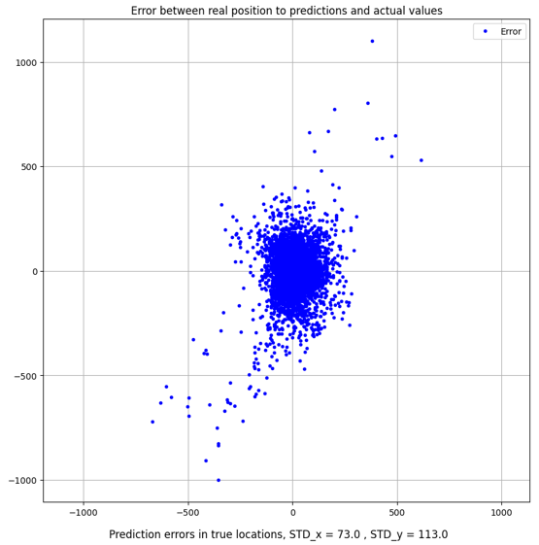
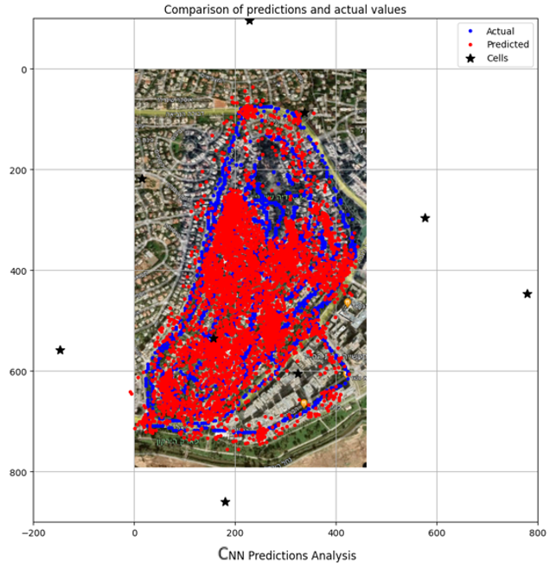
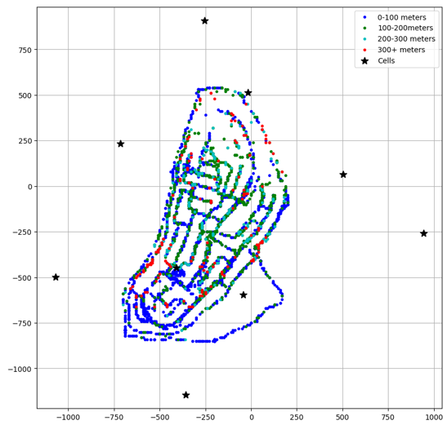
Results:

Slide 8
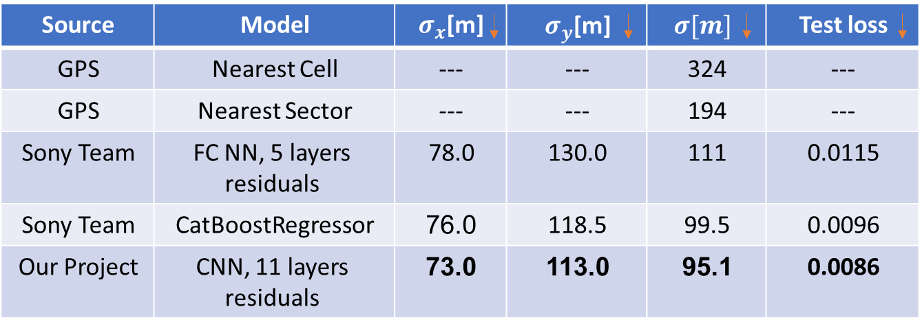
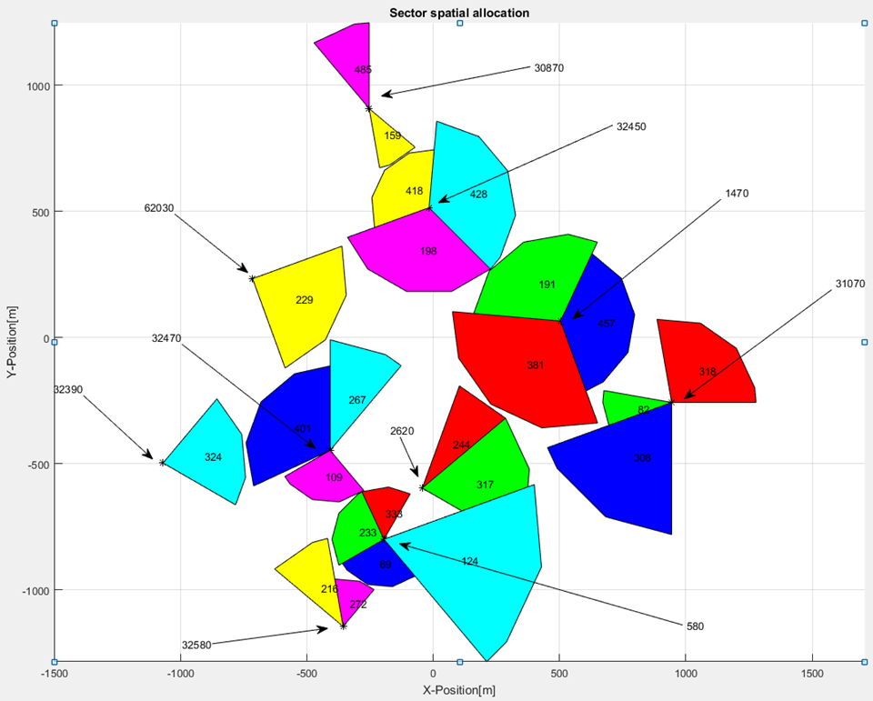
Results:
We can see that we achieved better results than the original project

Slide 9
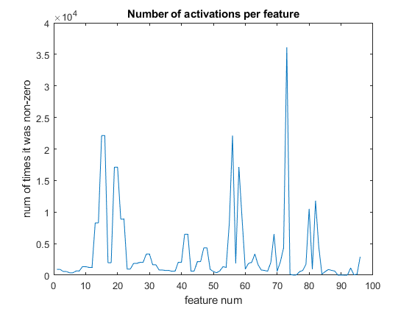
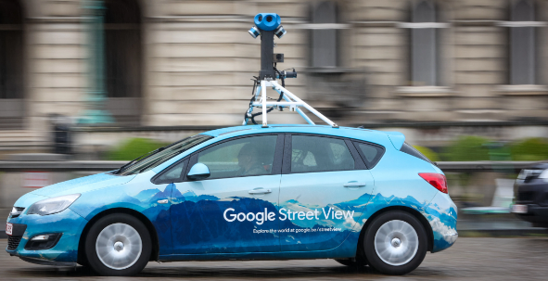
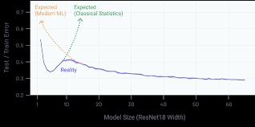
Future work ideas
Augmentations
Feature normalization
Double-deep gradient descent
World-wide dataset viability –
Google car for example

Slide 10



THANKS

